Slide 1
Frequency Comb Generation via Physics-Informed Bayesian Optimization
Zheming Li, Lucas Fernandez-Alcazar, Zin Lin,
Tsampikos Kottos

Slide 2
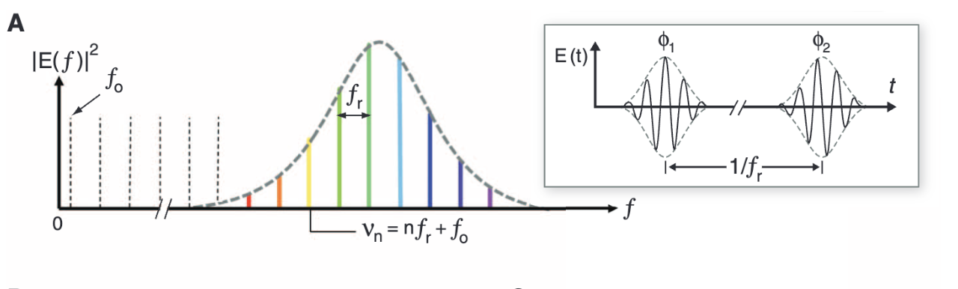
Frequency Combs
Applications
Clocking
High-capacity communications
Optical signal processing
T. J. Kippenberg et al. Science332,555-559(2011).
Notes:
Start by introducing combs, equally spaced peaks in the fourier transform spectrum
The time signal will resemble pulses or wave packets

Slide 3
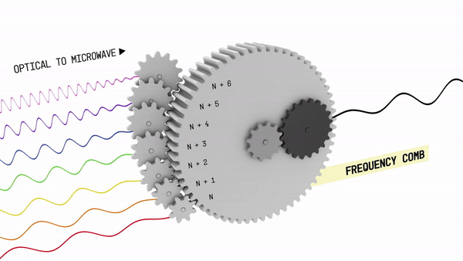
Clocking
Notes:
Schematic demonstration showing working principle of frequency combs in clocking.
Teeth of the frequency combs are like gears of different sizes that translate optical frequencies to microwaves, or vice versa.
Allows for more stable atomic clocks that have frequencies in the optical range. Frequency combs allows stable and accurate translation of these frequencies in the mesasureable range.

Slide 4
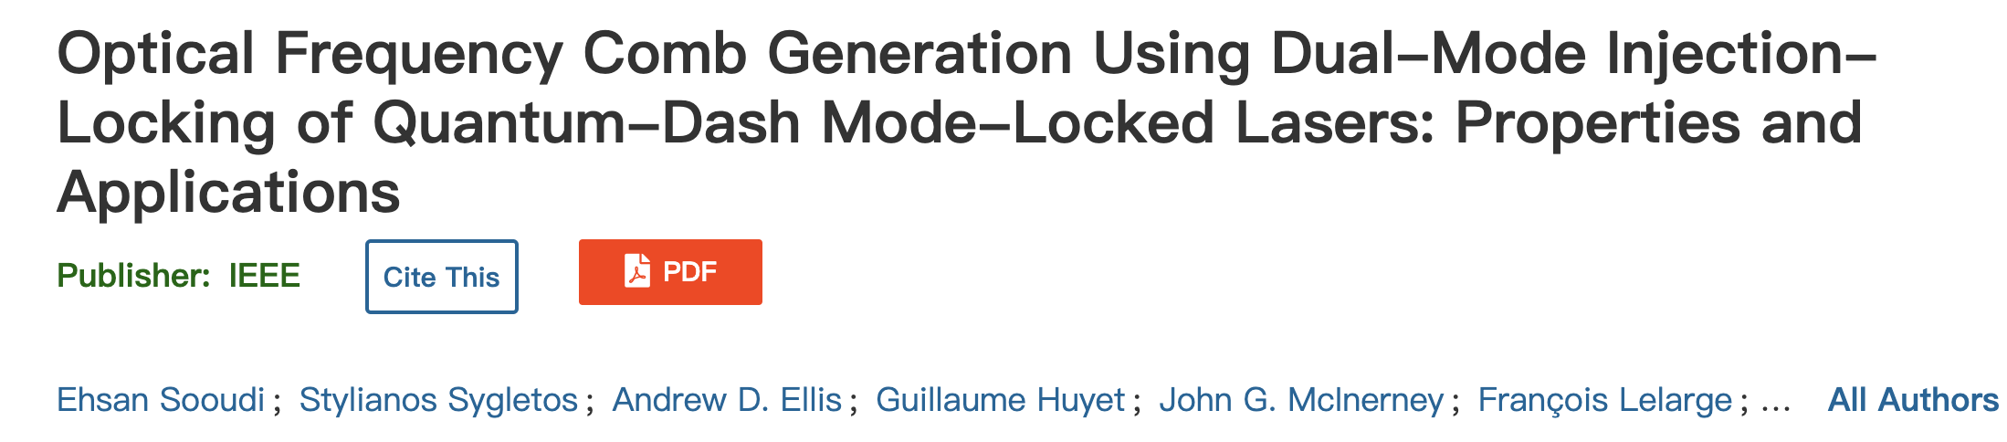
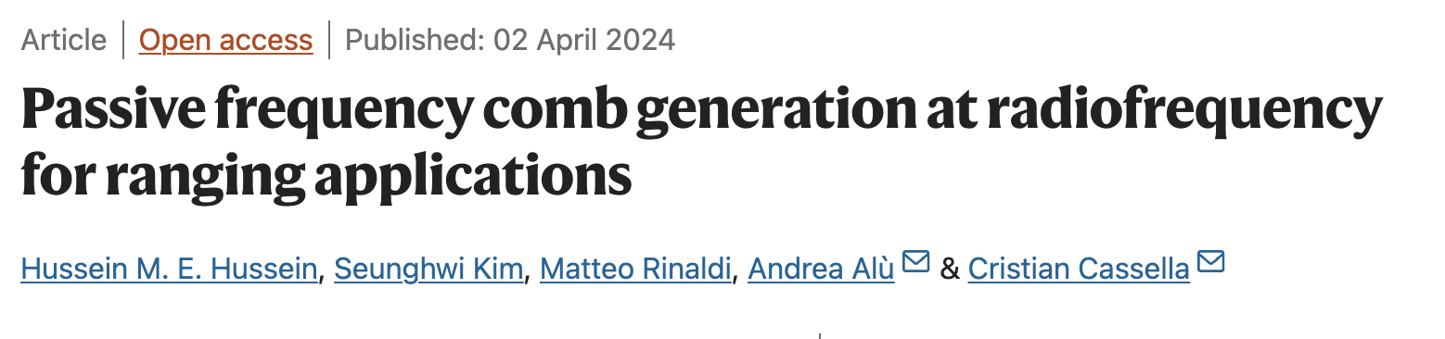
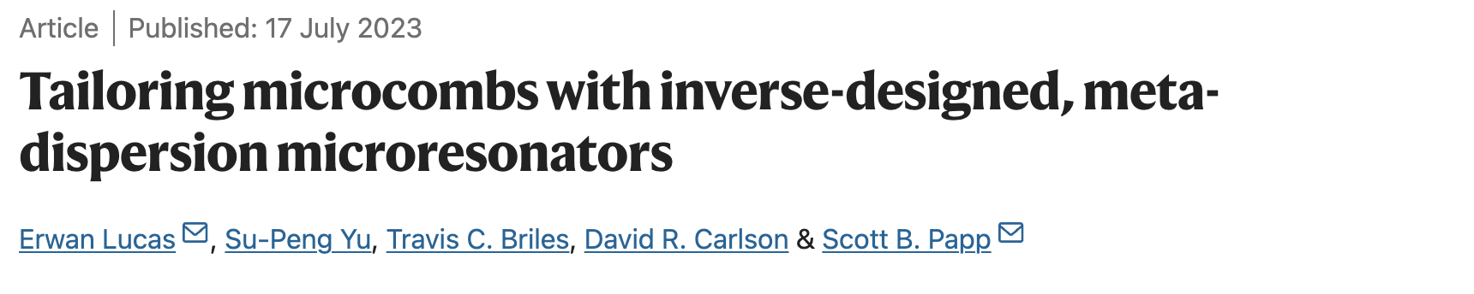
Recent Developments
Notes:
Add images of setup and frequency combs

Slide 5
Utilizing dynamical systems for frequency combs
Notes:
fixed points limit cycle chaotic system (Lorenz strange attractor)
Add goal: design frequency comb
Tells the story of different levels of complexity in dynamical system
Frequency combs arise naturally in the framework of dynamical system/limit cycles

Slide 6
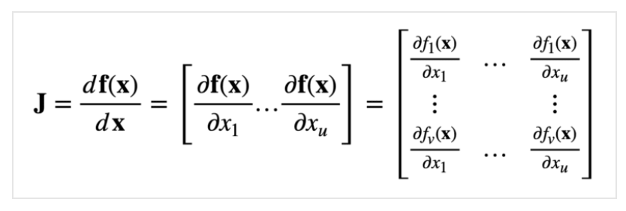
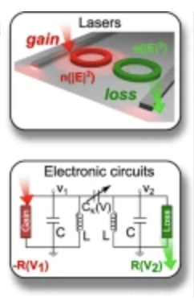
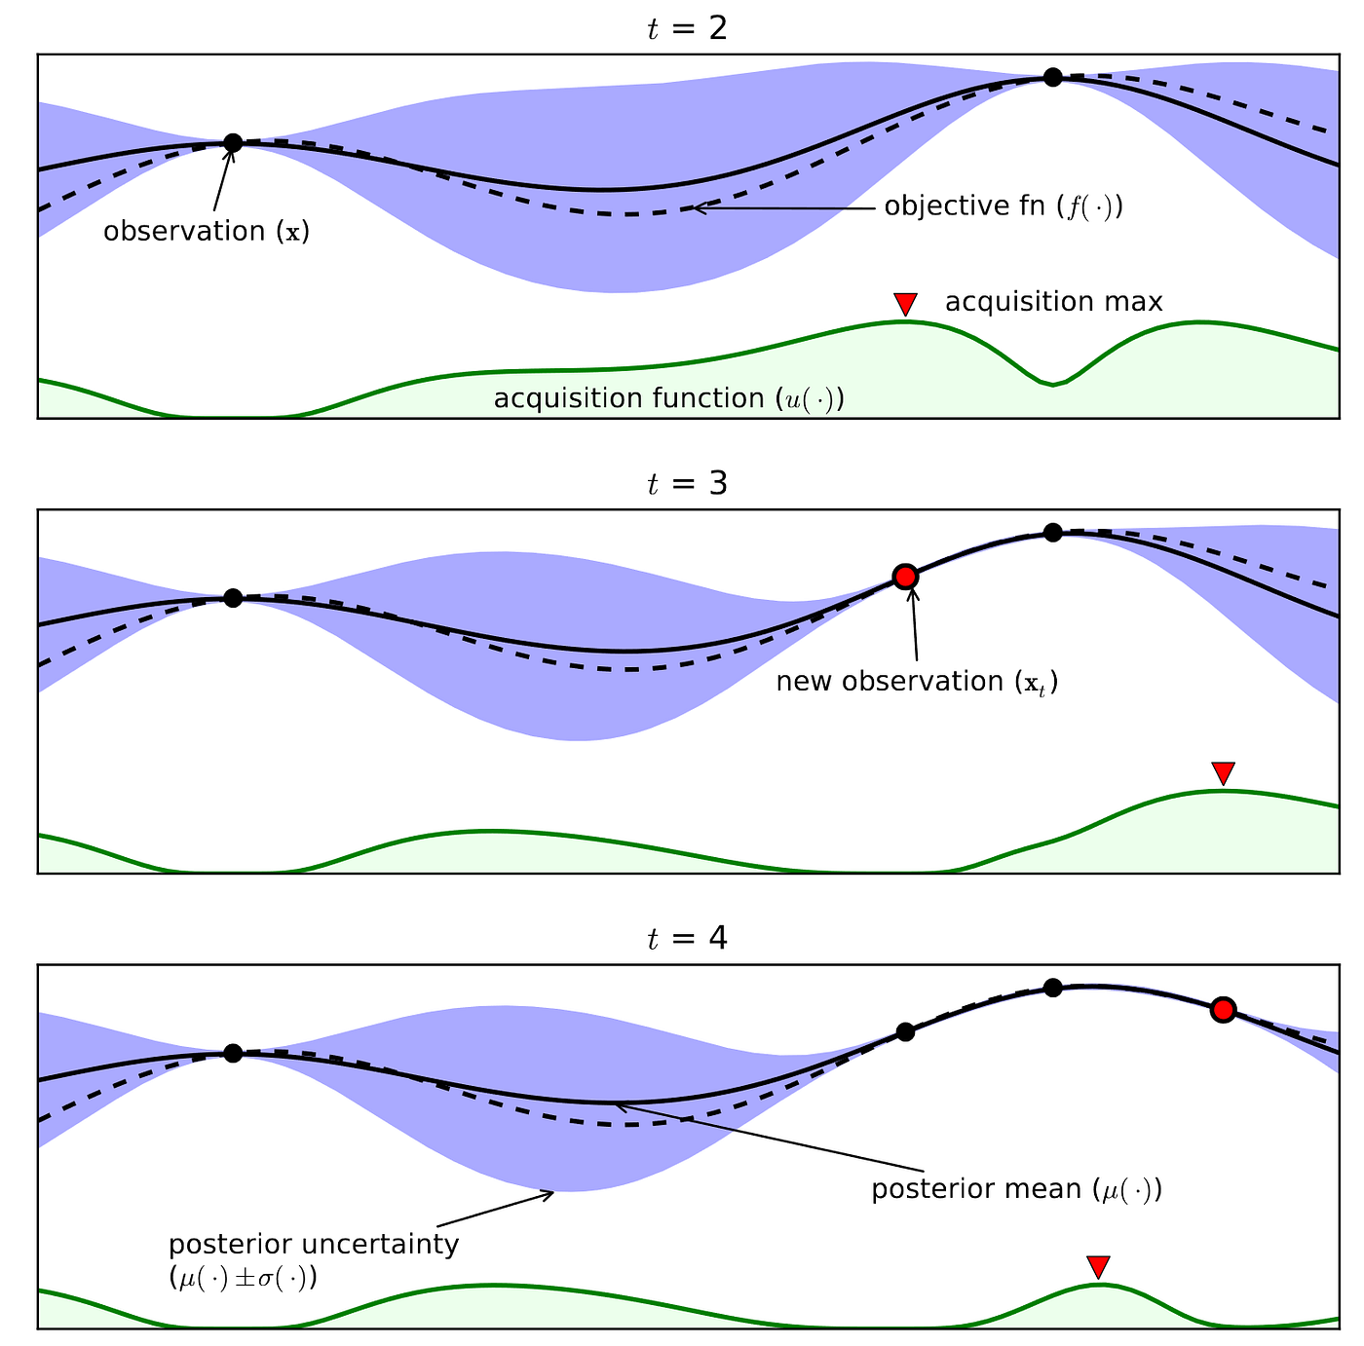
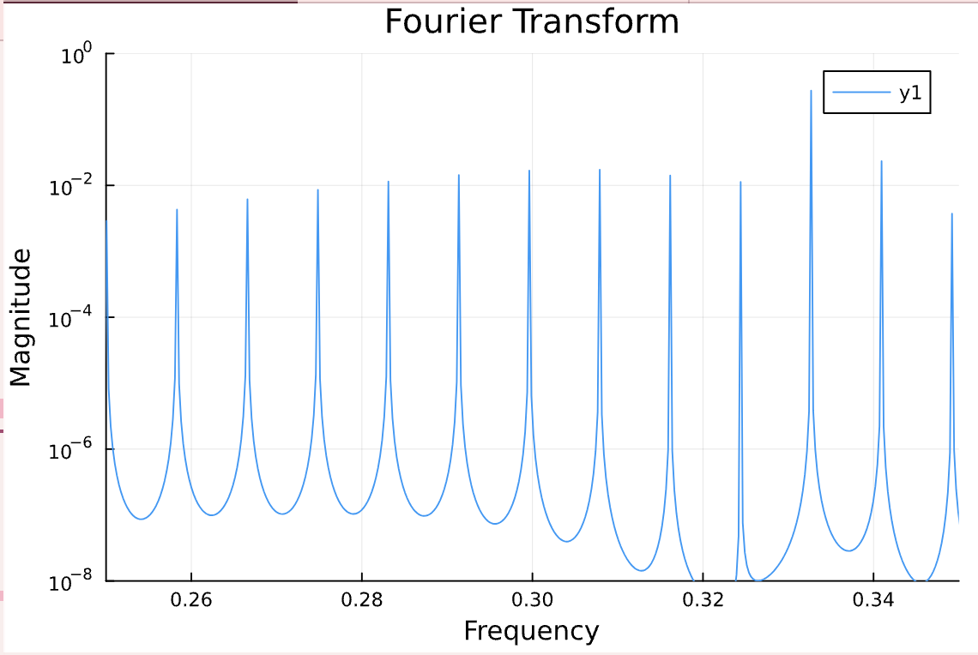
Physics-Informed Optimization
Laws of physics
Universal Modeling for Nonlinear Multi-cavity Systems
Bayesian Optimization
Optimal Parameters
magnitude (a.u)
frequency (a.u)
Suntharalingam, A., et al. Nat Commun 14, 5515 (2023)

Slide 7
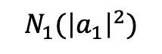
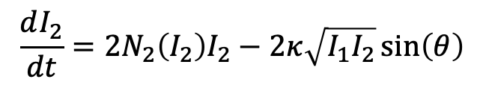
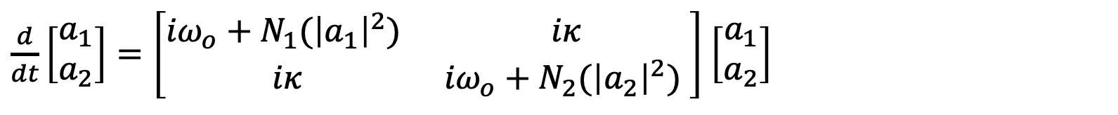
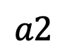
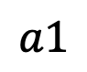


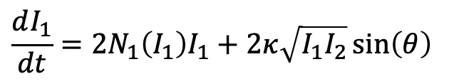
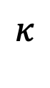

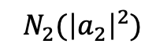
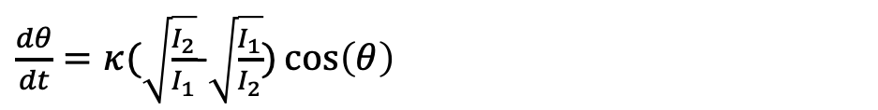
Universal Modeling: Coupled Mode Theory (CMT)
$$a1$$
$$a2$$
Multi-cavity Systems
$$ω_{o}$$
$$κ$$
$$ω_{o}$$
$$N_{1}({\left|a_{1}\right|}^{2})$$
$$N_{2}({\left|a_{2}\right|}^{2})$$
$\frac{d}{dt}\left[\begin{matrix}a_{1} \\ a_{2}\end{matrix}\right]=\left[\begin{matrix}{iω}_{o}+N_{1}({\left|a_{1}\right|}^{2}) & iκ \\ iκ & {iω}_{o}+N_{2}({\left|a_{2}\right|}^{2}) \end{matrix}\right]$ $\left[\begin{matrix}a_{1} \\ a_{2}\end{matrix}\right]$
In polar coordinates,
$$\frac{dI_{1}}{dt}=2N_{1}\left(I_{1}\right)I_{1}+2κ\sqrt{I_{1}I_{2}}\sin\left(θ\right)$$
Where $a_{n}\left(t\right)=I_{n}^{\frac{1}{2}}\left(t\right)e^{iφ_{n}\left(t\right)}$ and $θ=φ_{2}−φ_{1}$
$$\frac{dI_{2}}{dt}=2N_{2}\left(I_{2}\right)I_{2}−2κ\sqrt{I_{1}I_{2}}\sin\left(θ\right)$$
$\frac{dθ}{dt}=κ(\sqrt{\frac{I_{2}}{I_{1}}}$-$\sqrt{\frac{I_{1}}{I_{2}}})\cos\left(θ\right)$
Notes:
More details for CMT
Add animation for corresponding elements

Slide 8
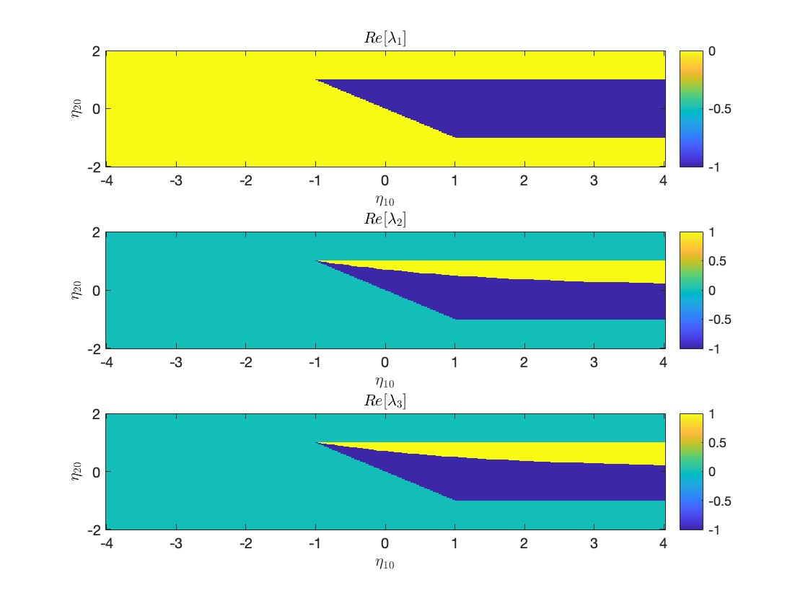
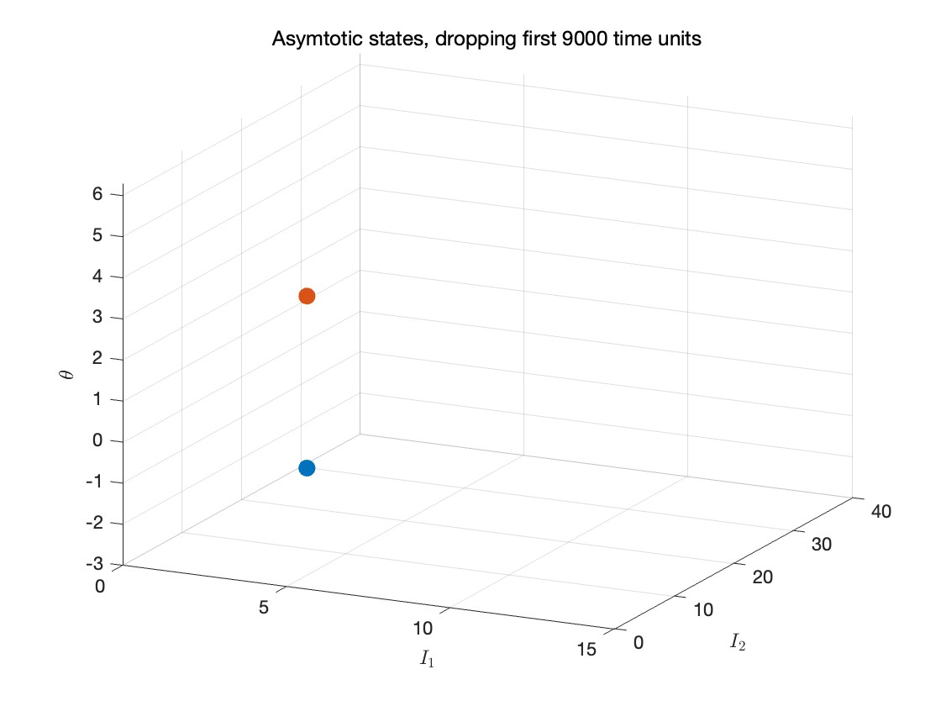
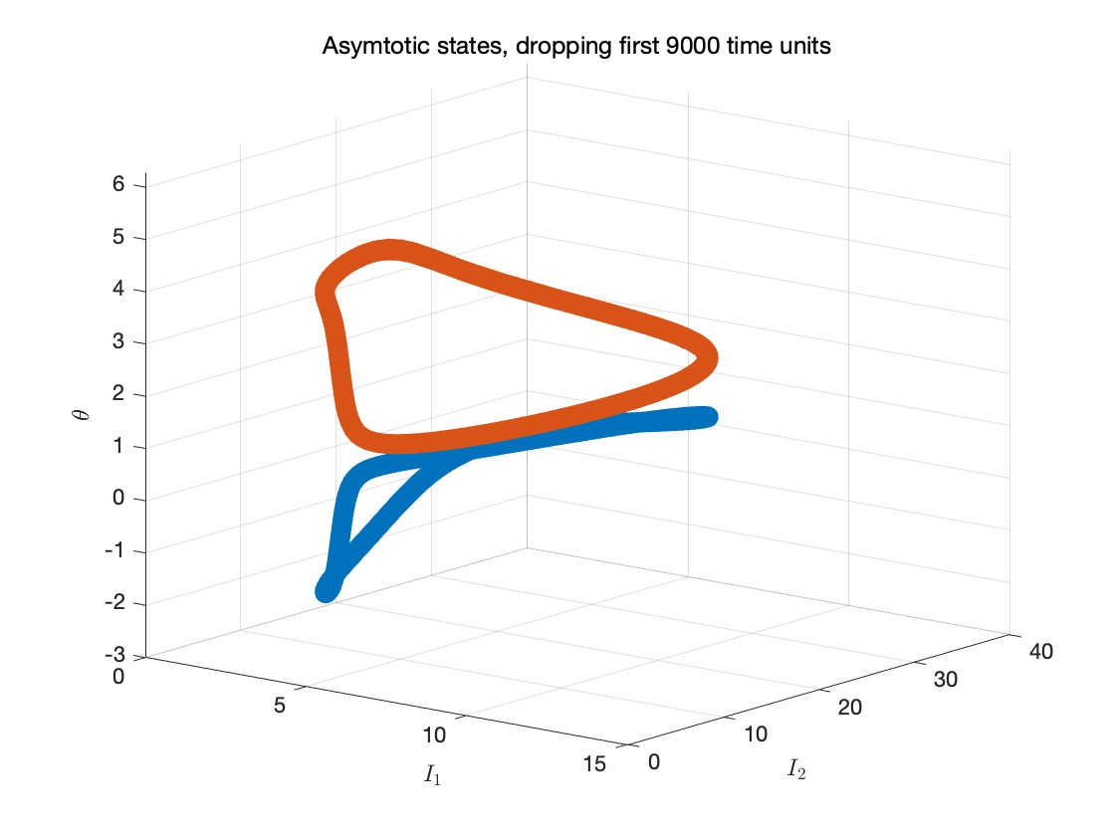
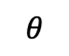
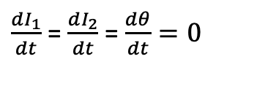

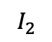
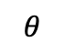
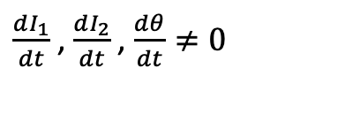
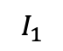
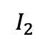
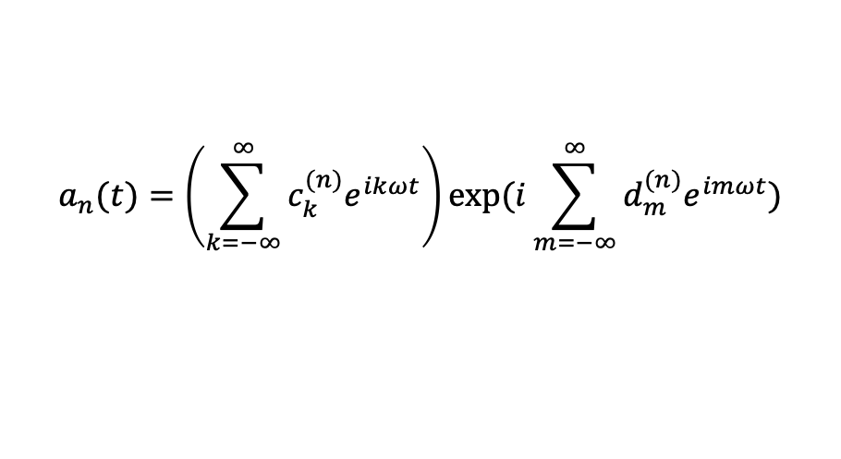
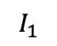
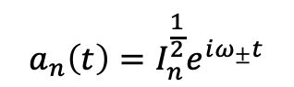
Dynamical State Classification
param1
I. Fixed points solutions:
II
Unbounded/trivial
$\frac{dI_{1}}{dt}$ = $\frac{dI_{2}}{dt}$ = $\frac{dθ}{dt}=0$
I
$$a_{n}\left(t\right)=I_{n}^{\frac{1}{2}}e^{iω_{±}t}$$
param 2
I.
II.
II. Limit cycle solutions:
$$θ$$
$$θ$$
$\frac{dI_{1}}{dt}$ , $\frac{dI_{2}}{dt}$ , $\frac{dθ}{dt}≠0$
$$I_{1}$$
$$I_{2}$$
$$I_{1}$$
$$I_{2}$$
$$a_{n}(t)=\left(\sum_{k=−∞}^{∞}{c_{k}^{(n)}e^{ikωt}}\right)exp⁡(i\sum_{m=−∞}^{∞}{d_{m}^{(n)}e^{imωt}})$$
Challenge:
The coefficients $c_{k}^{(n)}$ and $d_{m}^{(n)}$ are analytically intractable

Slide 9
Physics-Informed Optimization
Laws of physics
Universal Modeling for Multi-cavity Systems
Bayesian Optimization
Suntharalingam, A., et al. Nat Commun 14, 5515 (2023)

Slide 10
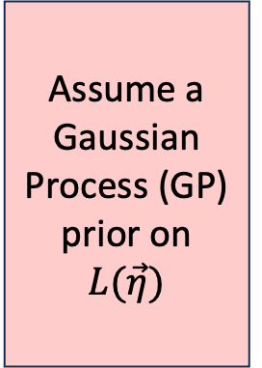
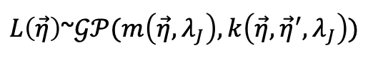
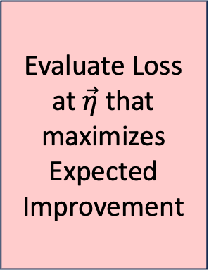
Bayesian Optimization
Task:$\min_{\vec{η}∈ℝ^{d}}{L\left(\vec{η}\right) subject to\max\left({Re[λ}_{J}(\vec{η})]\right)≥0}$
Limit cycle condition
No
Assume a Gaussian Process (GP) prior on $L(\vec{η})$
Evaluate Loss at $\vec{η}$ that maximizes Expected Improvement
Update GP by computing conditional distribution
Reached termination criterion?
Yes
End
Physics
Jacobian Information
$L\left(\vec{η}\right)$~$𝒢𝒫(m\left(\vec{η},λ_{J}\right), k\left(\vec{η},{\vec{η}}^{′}, λ_{J}\right))$

Slide 11
Bayesian Optimization
Brochu, E., et al. Retrieved from https://arxiv.org/abs/1012.2599
Notes:
Combine 10 and 11
Keep 2
Make comparison between physics-agnostic and physics -informed

Slide 12
Physics-Informed Optimization
Laws of physics
Universal Modeling for Multi-cavity Systems
Bayesian Optimization
Optimal Parameters
magnitude (a.u)
frequency (a.u)
Suntharalingam, A., et al. Nat Commun 14, 5515 (2023)

Slide 13
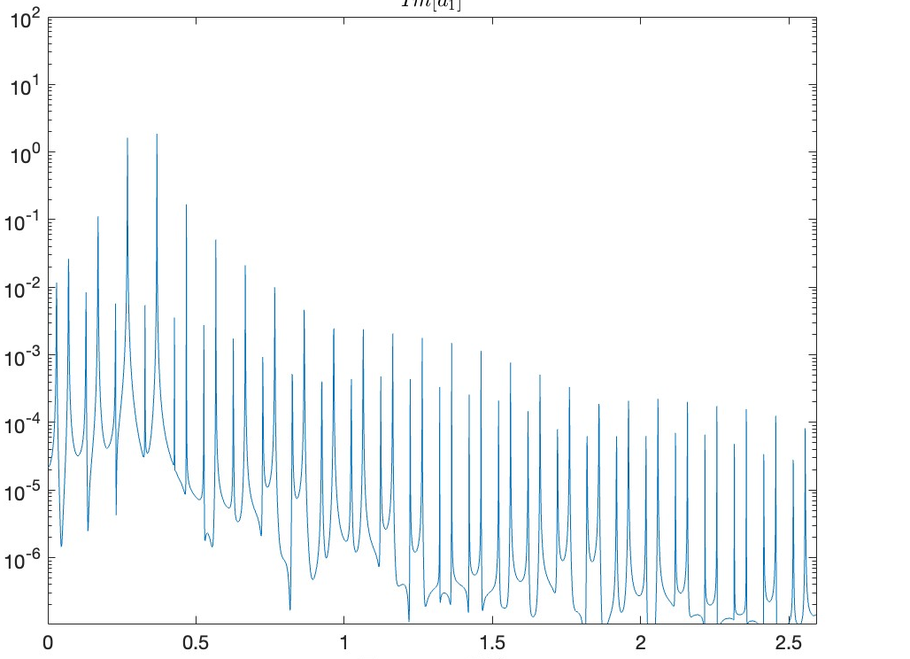
Results: Coupled Mode Theory (CMT)
Single dimer
Two dimers
Magnitude
Magnitude
Frequency (Hz)
Frequency (Hz)

Slide 14
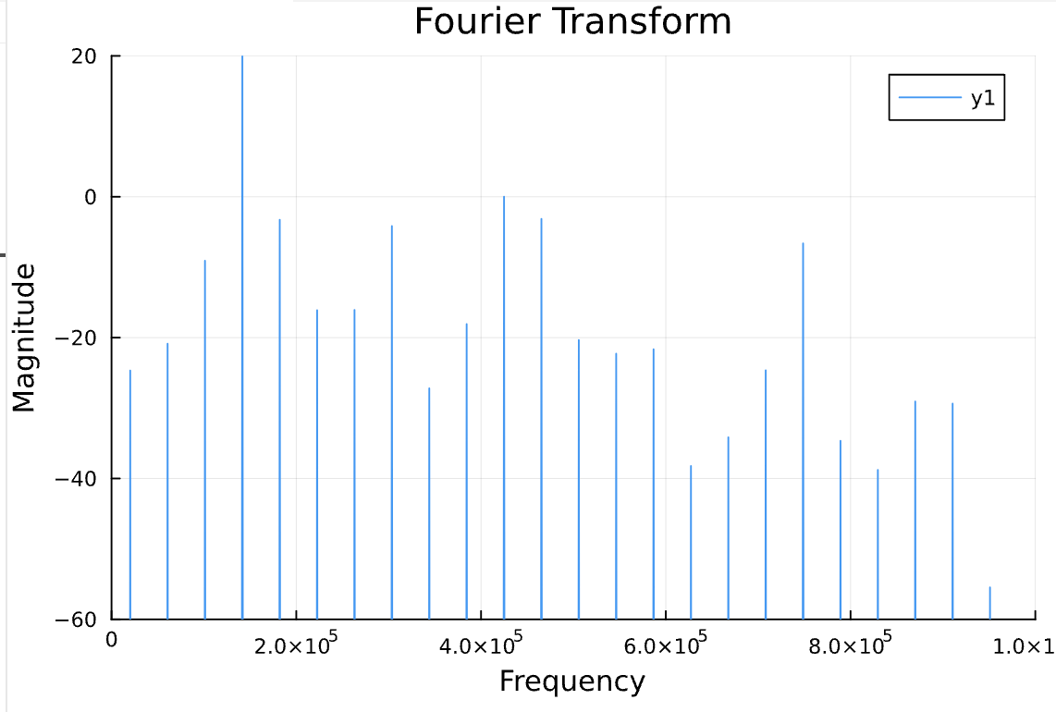
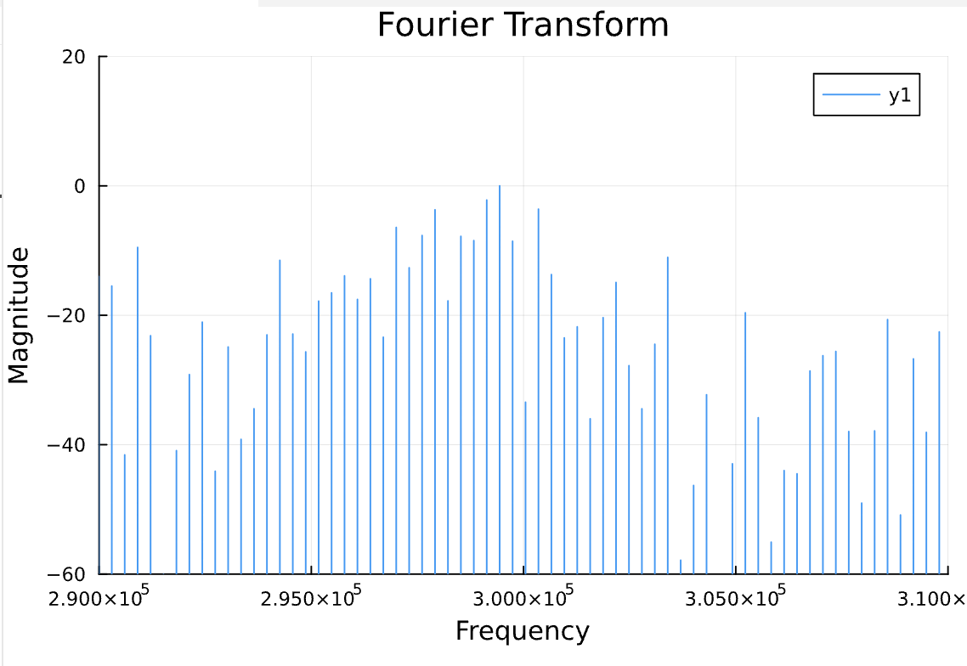
Results: Realistic Circuit Simulation (NGSpice)
Single dimer
Two dimers
Notes:
Add CMT results

Slide 15
Thank you!

